Slide 1
BLE - Raspberry Pi Pico
React Native

Slide 2

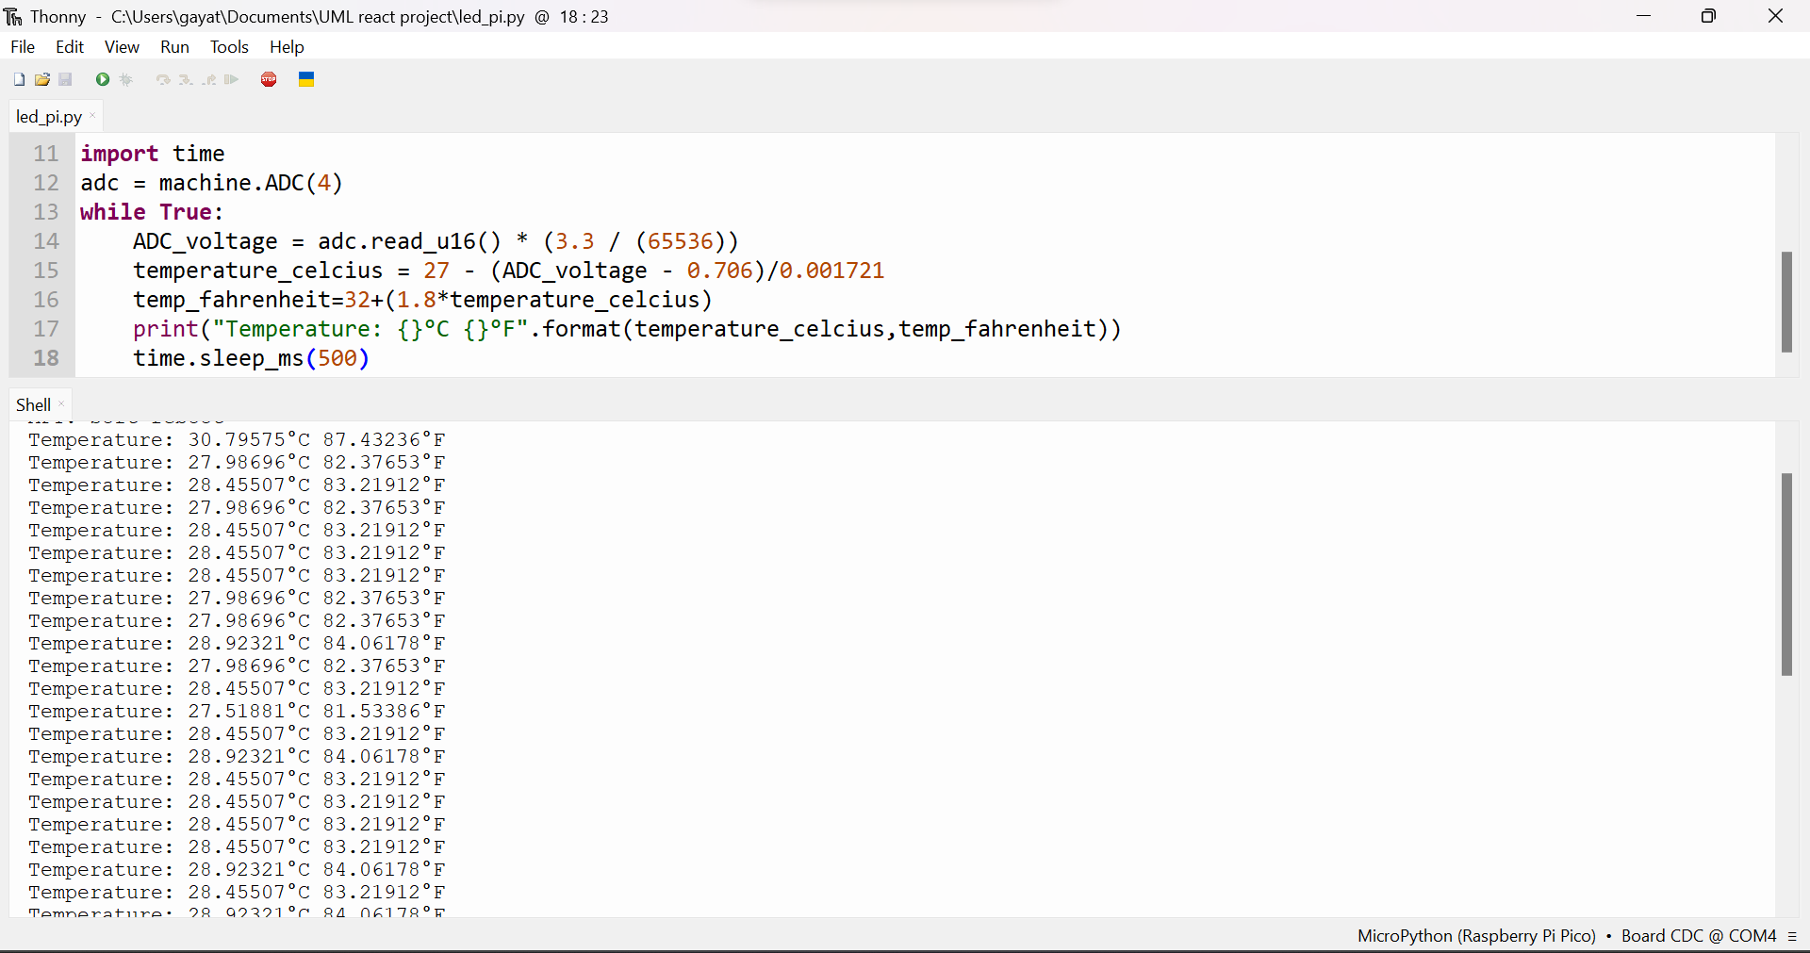
Last Week (11/Sep – 17/Sep)
Initially, read temperature from Pi Pico using micro python
Using React Native, built a sample app from scratch.
Tried to implement, stream data from Pi Pico to HiveMQ.

Slide 3
Next Week (18/Sep – 24/Sep)
Learn about MQTT & HiveMQ
Send data from Pi Pico to HiveMQ
Setup node project for client and server creation

Slide 4
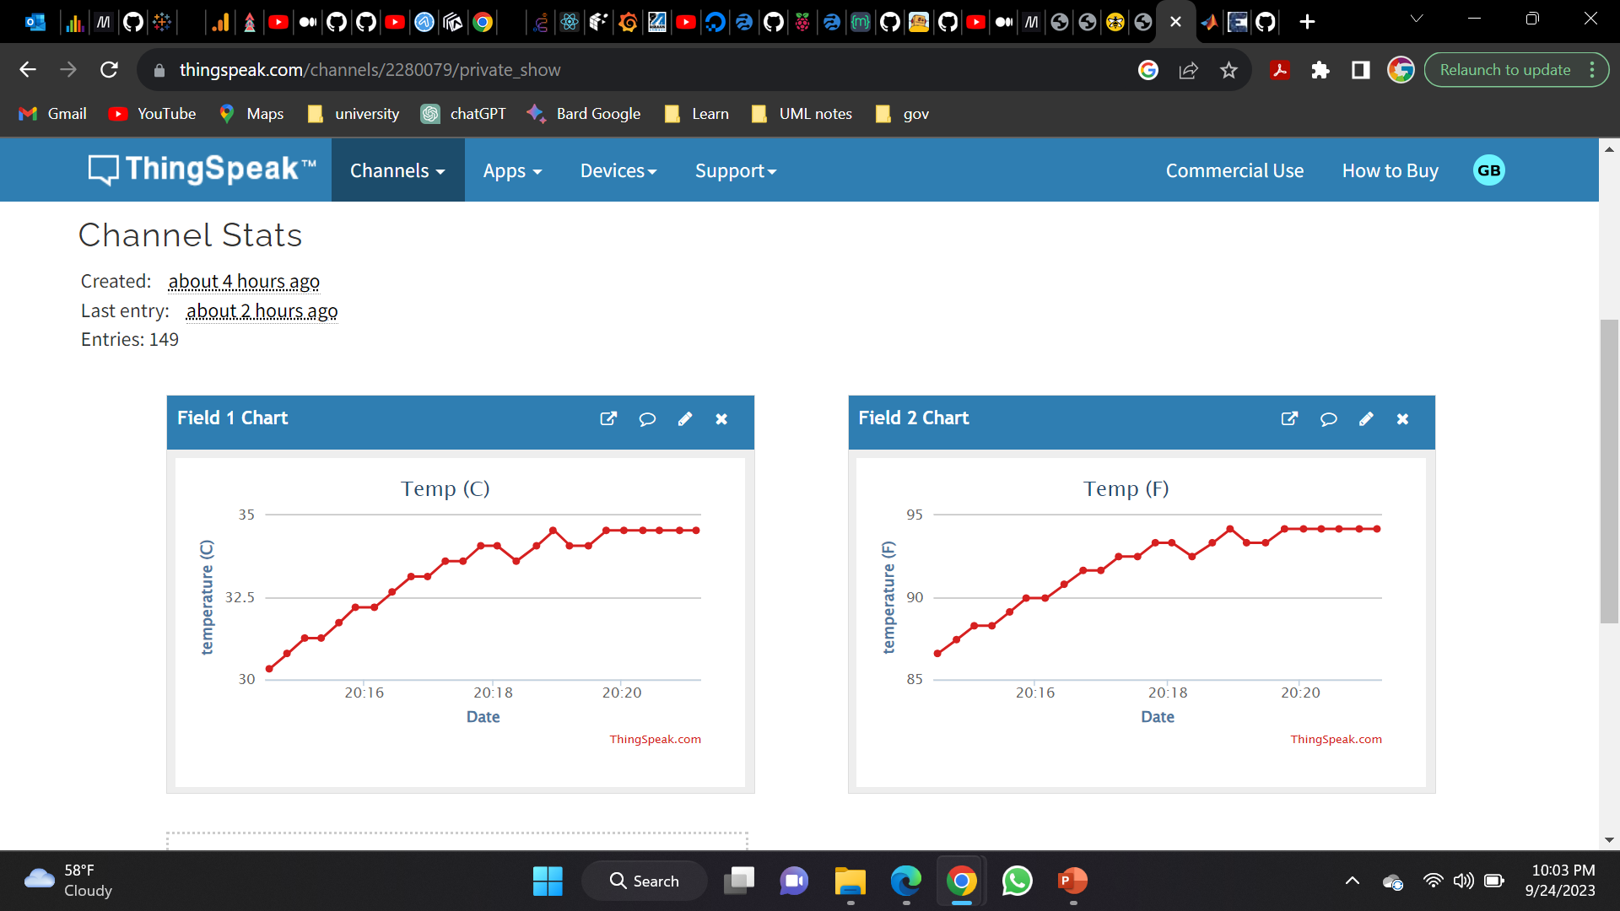
Last Week (18/Sep – 24/Sep)
Send data from Pi Pico to ThingSpeak
Visualized temperature data as a chart for every 500ms.

Slide 5
Next Week (25/Sep – 01/Oct)
BLE connection with Pi Pico

Slide 6
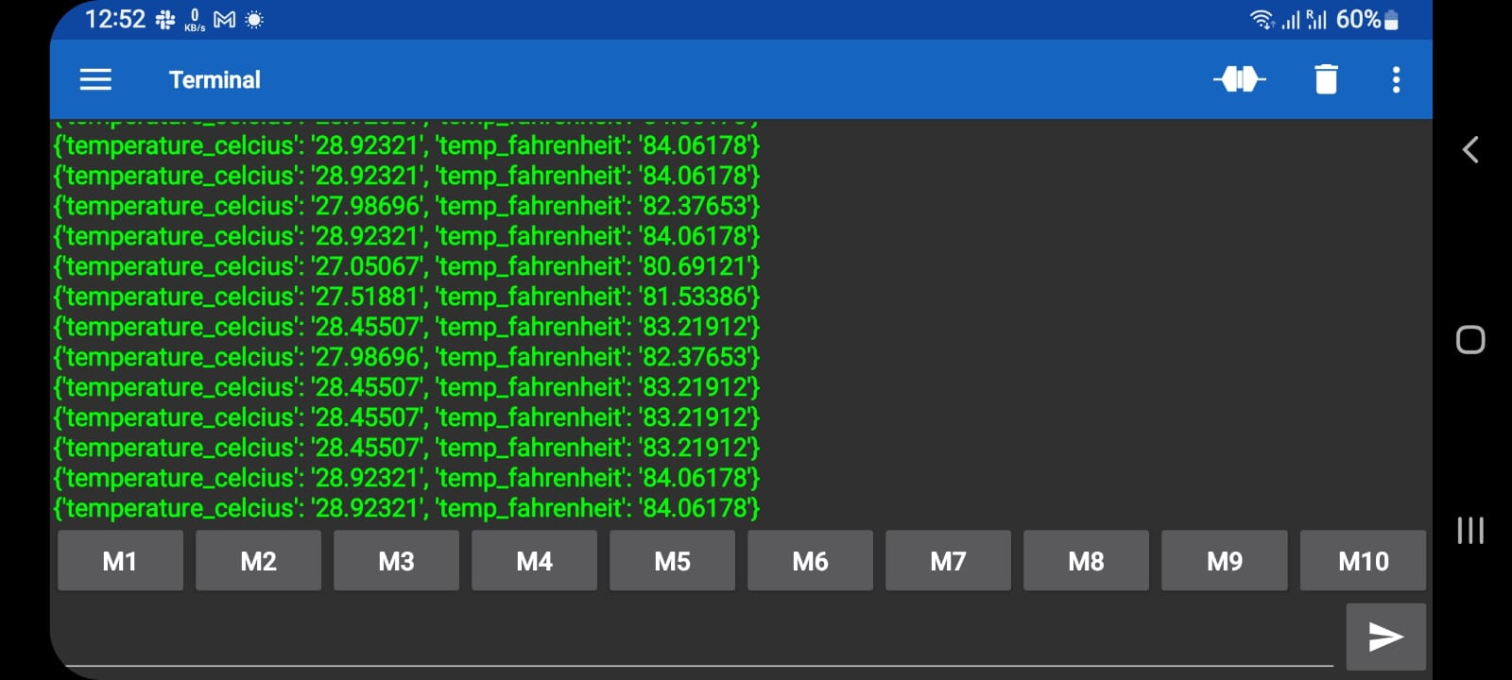
Last Week (25/Sep – 01/Oct)
Sent temperature from Pi Pico to 3rd party mobile App
Connected through Bluetooth and collected temperature.

Slide 7
Next Week (02/Oct – 08/Oct)
Work on mobile App to display temperature, using ReactNative.

Slide 8
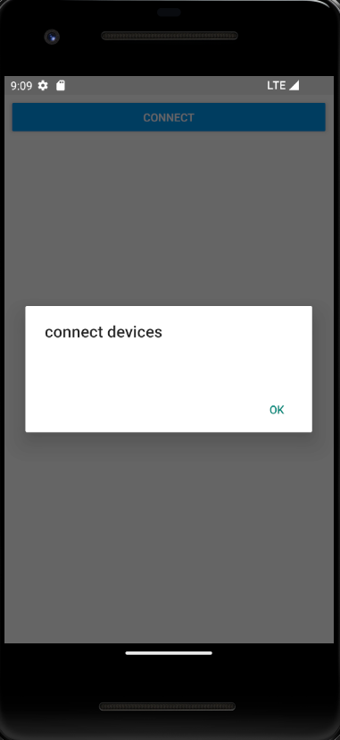
Last Week (02/Oct – 08/Oct)
Tried to scan Bluetooth devices using React Native in mobile App
Resolving error in Bluetooth module and packages

Slide 9
Next Week (09/Oct – 15/Oct)
Scan Bluetooth through mobile App
Collect data from Pi Pico and show in App

Slide 10
Last Week
Tried to scan nearby Bluetooth devices
Tried using package named ‘BluetoothSerial’
Unable to import Bluetooth modules in react-native

Slide 11
Next Week (23/Oct – 29/Oct)
Scan Bluetooth through mobile App
Collect data from Pi Pico and show in App

Slide 12
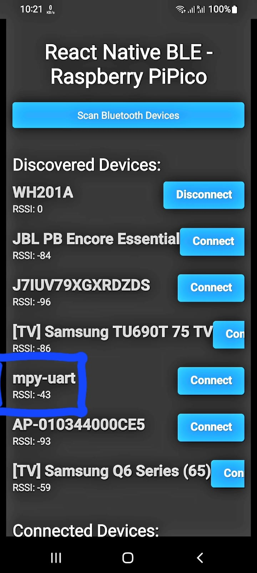
Last Week (23/Oct – 29/Oct)
Connected Bluetooth classic (head-phone/speaker) devices using
“react-native-ble-manager” package.
Trying to connect Bluetooth low energy (Raspberry PiPico) devices using
“react-native-ble-plx” package.

Slide 13
Next Week (30/Oct – 05/Nov)
Connect PiPico using “react-native-ble-plx” package.
Collect and display data in App.

Slide 14
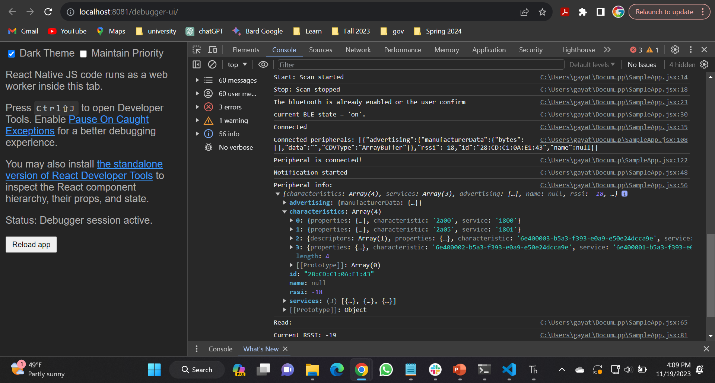
Last Week
Rendered UUID details
Working on temperature data.

Slide 15
Next Week
Must figure out why “read” has empty response.
Render temperature data.

Slide 16
When internet is connected,
From Mobile Send to
Cloud Storage
Using ReactNative,
Mobile App collects data through Bluetooth
Store it in local
Using Node, pass data from cloud to React
Raspberry Pi Pico
Micro Python
Send data through BLE
Using React, see data visualization in browser

